Slide 1
Comprehensive Digital Marketing
Project Work

Slide 2
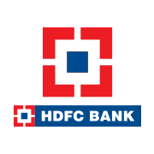
Company: HDFC BANK

Slide 3
Research Brand Identity
Mission/Values:
These bank is committed to maintaining the highest level of ethical standards, professional integrity, corporate governance and regulatory compliance. HDFC Bank’s business philosophy is based on 5 core values: Operational Excellence, Customer Focus, Product Leadership, people and sustainability.
USP (UNIQUE SELLING PREPOSITIONS):
HDFC bank is a one of the big four banks in India. It is a one of the leading brands in the banking & financial service sector.

Slide 4
Analyze Brand Messaging:
HDFC stands for reliability, affordability and approachability.
These branch feels like a part of the family.
Examine the brand's tagline:
The tagline of HDFC bank is “We Understand Your World.”

Slide 5
Competitor Analysis
Competitor 1: https://www.axisbank.com/
USP: Axis bank is one of the largest private sector financer in Indian Agriculture.
COMMUNICATION: Social media advertisements, User generated content.
Competitor 2: https://www.icicibank.com/
USP: ICICI is the most efficient and tech Savvy bank in the Indian banking industry.
COMMUNICATION: Media advertisement, Value based content.
Competitor 3: https://www.kotak.com/en/home.html
USP: Professionalism in Banking.
COMMUNICATION: Celebrity Endorsements, Tips & Tricks.

Slide 6
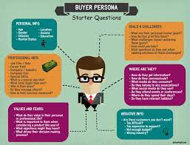
Buyer's/Audience's Persona: Clearly define the target audience for the chosen brand. Consider demographics, psychographics, behaviors, and interests.
HDFC:
Age: 16 Years and above
Gender: Male / Female
Married / Unmarried
Location: They have a lot of
branches in all cities and towns.
But, they don’t have branches in
Remote Villages.
They promote their brand through
Ads, Youtube, Instagram, etc.
These bank targeted at Individuals, Salaried
professionals, small businesses and also
for Non-Resident Indians. .

Slide 7
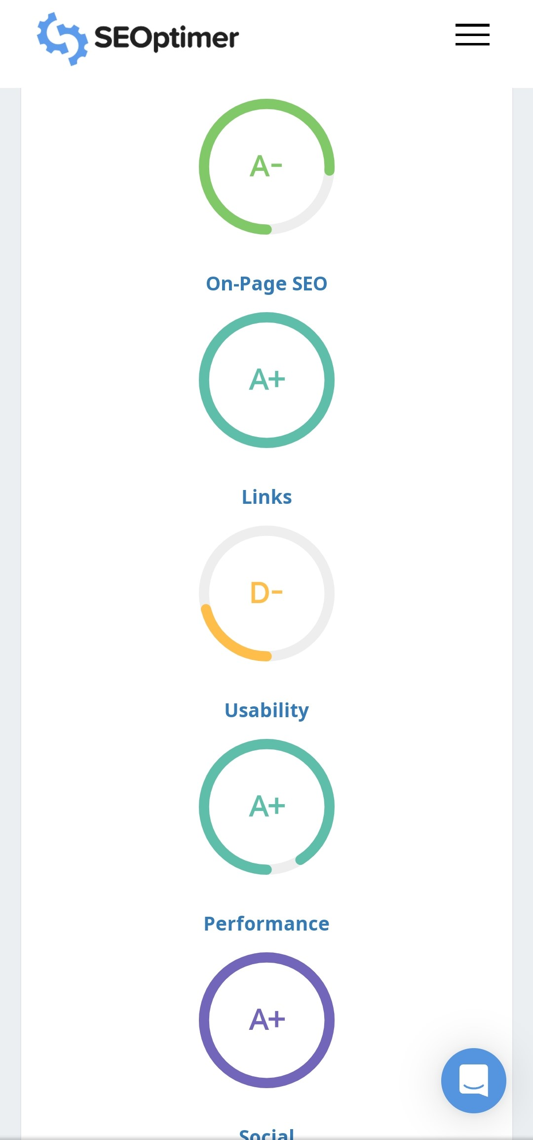
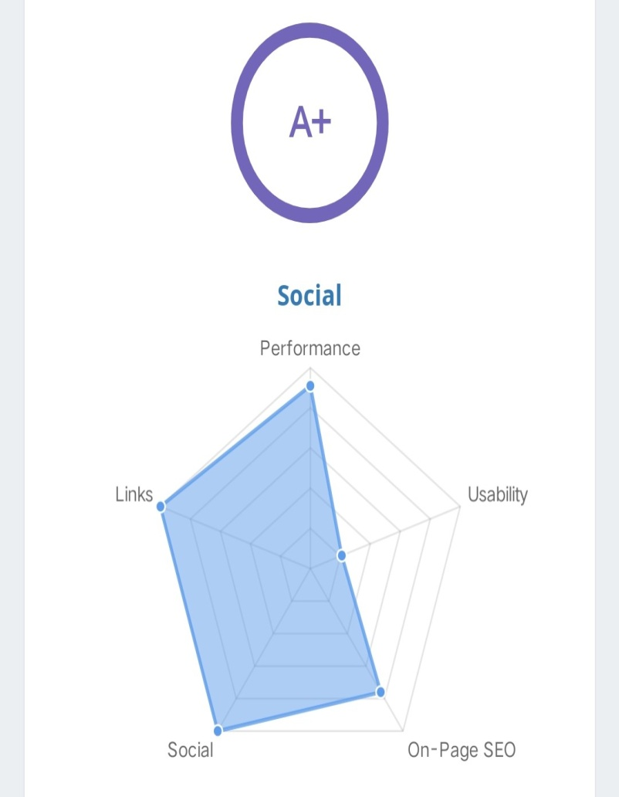
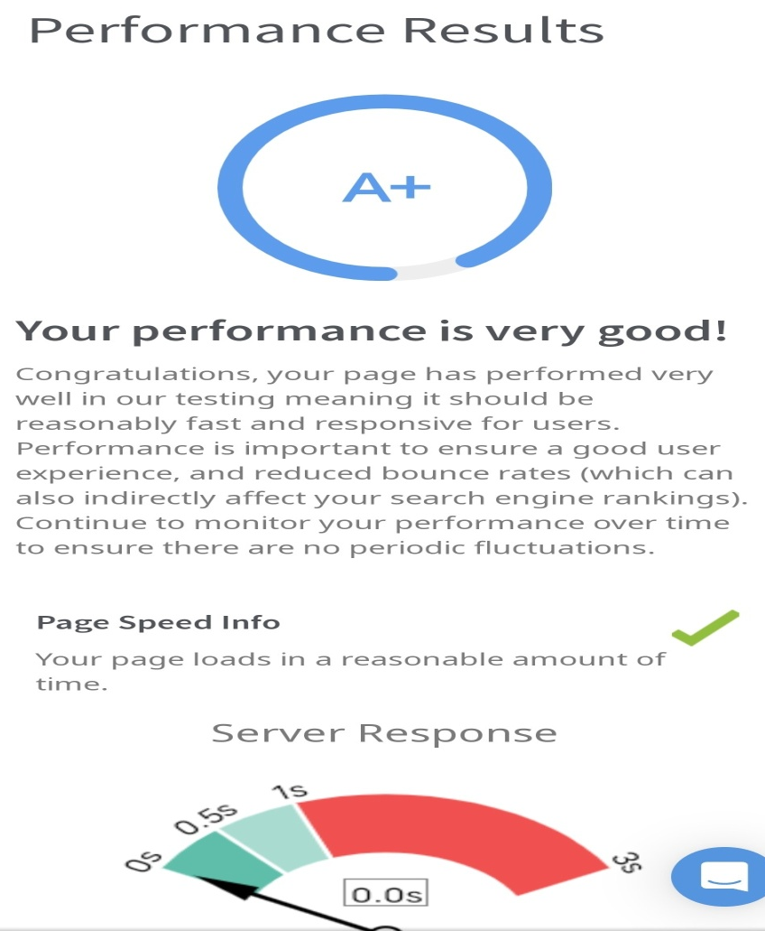
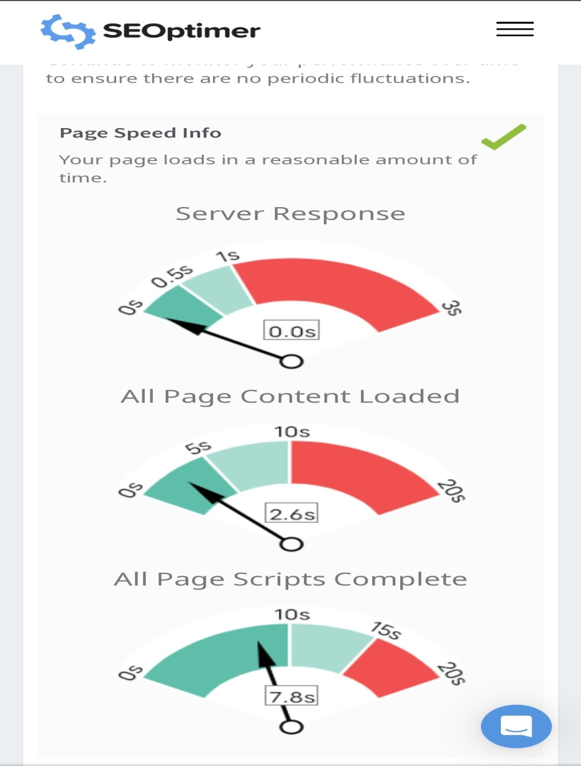
Part 2: SEO & Keyword Research
SEO Audit:

Slide 8
Keyword Research:
Rank | HDFC Ltd Share Keywords | Global Search Volume | Cost Per Click | PD (Paid Difficulty)
1 | HDFC netbanking | 29941700 | 0.00 | 0
2 | HDFC | 4165800 | 0.00 | 0
3 | HDFC bank | 2943300 | 0.00 | 1
4 | HDFC bank netbanking | 417500 | 0.00 | 0
5 | Itd | 287300 | 0.00 | 0
6 | HDFC homeloan | 243900 | 0.00 | 23
7 | Online HDFC | 150000 | 0.00 | 0
8 | HDFC Smartbuy | 142600 | 0.00 | 1
9 | HDFC net | 118300 | 0.00 | 1
Global Search Volume

Slide 9
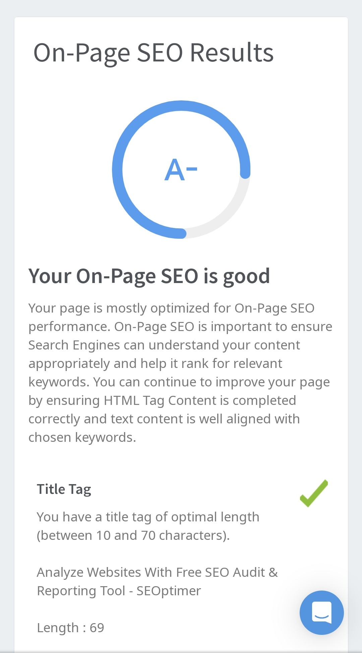
On page Optimization:
These page is mostly optimized for
On-Page SEO performance.
This is important to ensure Search
Engines can understand your
content appropriately and help it
rank for relevant Keywords.
You can continue to improve your
page by ensuring HTML Tag
content is completed correctly
and text content is well aligned
with chosen keywords.

Slide 10
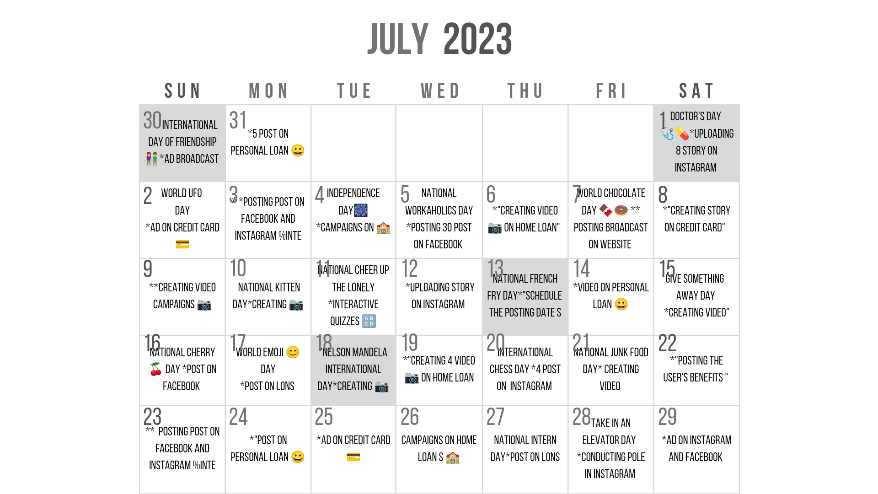
Part 3: Content Ideas and Marketing Strategies
Content Idea Generation & Strategy:

Slide 11
Part 3: Content Ideas and Marketing Strategies
We have uploaded a lot of posts in Social Media Website like Instagram, Facebook, Gmail, Twitter etc. We have done a lot of activities for promoting our HDFC bank. We explain about the activities through this calendar.
HDFC Bank is very active on social media. A maximum number of their social media posts contain publicity of their campings as well as awareness messages. Their content also revolves around the new features or apps launched by HDFC.
HDFC Bank has a wide range of banking services ranging from commercial and investment banking on the wholesale side to transactional / branch banking on the retail side. It has 3 key business segments: Wholesale Banking, Retail Banking, and Treasury.

Slide 12
Part 4: Content Creation and Curation (Post creations, Designs/Video Editing, Ad Campaigns over Social Media and Email Ideation and Creation)
Format 1: Blog article and Post Creations
Format 2: Video/Designs Editing
Format 3: Ad Campaigns

Slide 13
Blog article on HDFC Bank
HDFC Bank launched a new program that is “HDFC Bnak’s Festive Treats”.
In these blog we about the details and benefits of these program. Everyone loves the festive season for different reasons; holidays, exuberant family celebrations, Diwali bonuses, large meal spreads and others. But another element that is synonymous with this season is the plethora of shopping opportunities it brings.

Slide 14
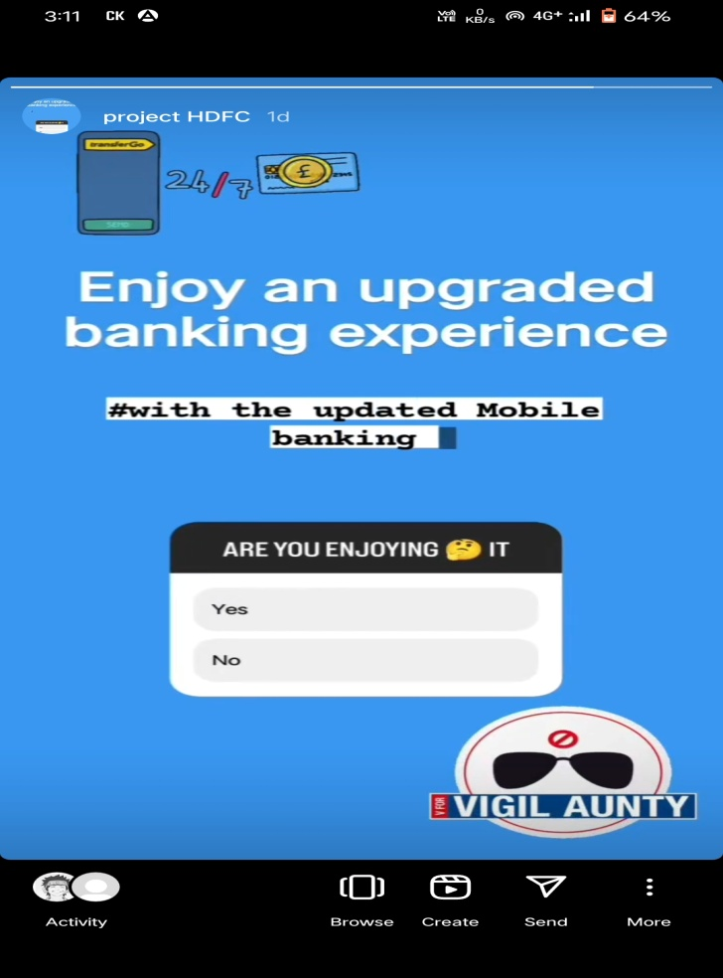
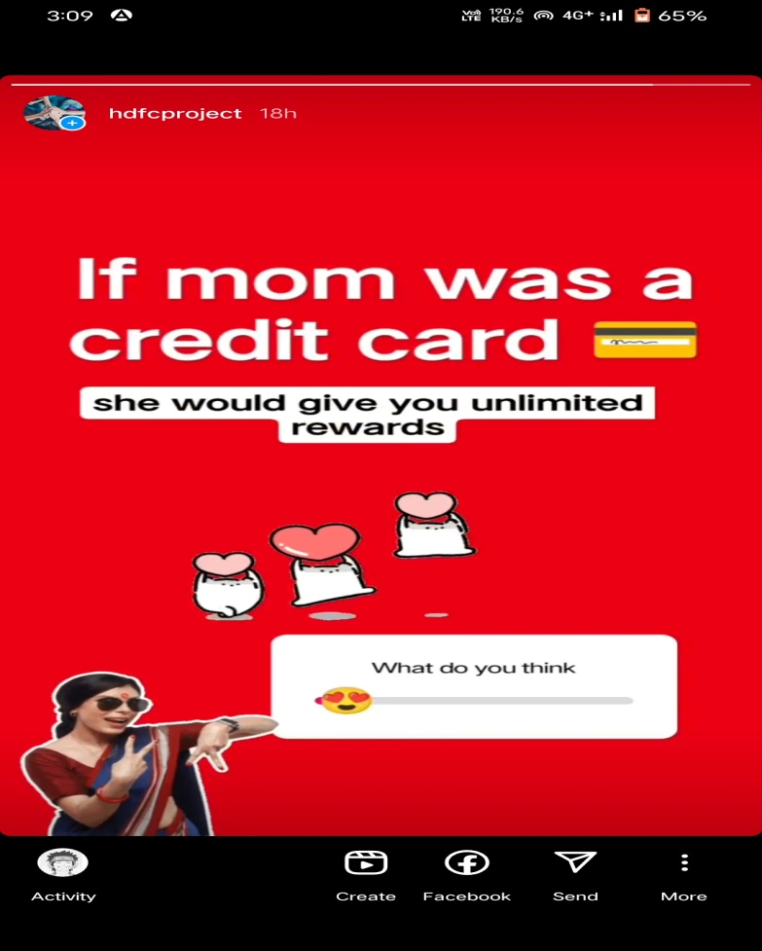
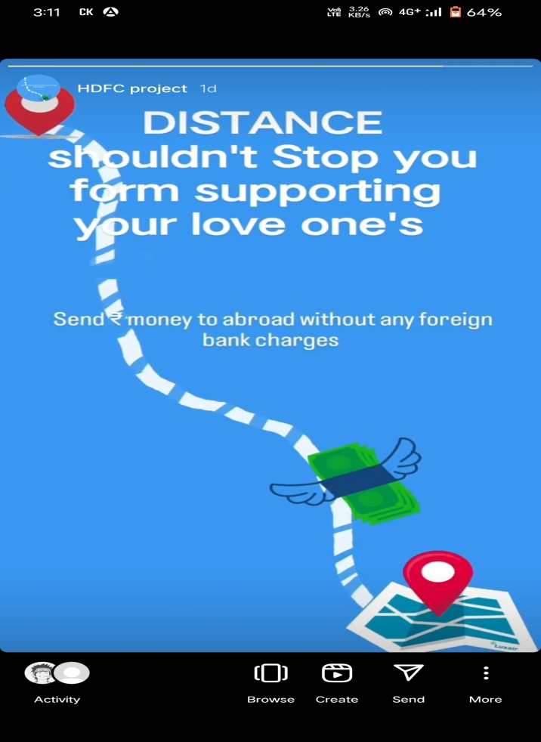
Instagram Story
Instagram Link: https://www.instagram.com/s/aGlnaGxpZ2h0OjE4Mjc2Mjk5NjA1MTgzMTMw?story_media_id=3154537870701565341_61042353734&igshid=MTc4MmM1YmI2Ng==

Slide 15

Designs/Video Editing on HDFC Bank

Slide 16
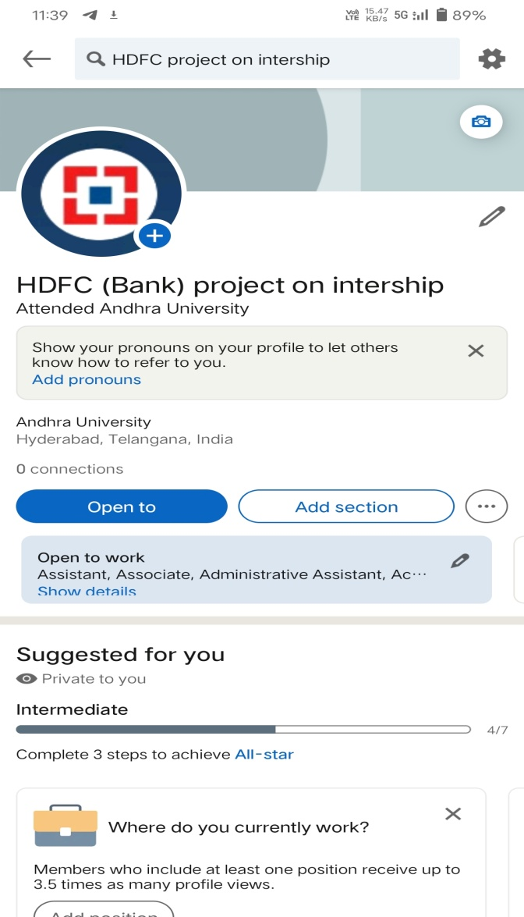
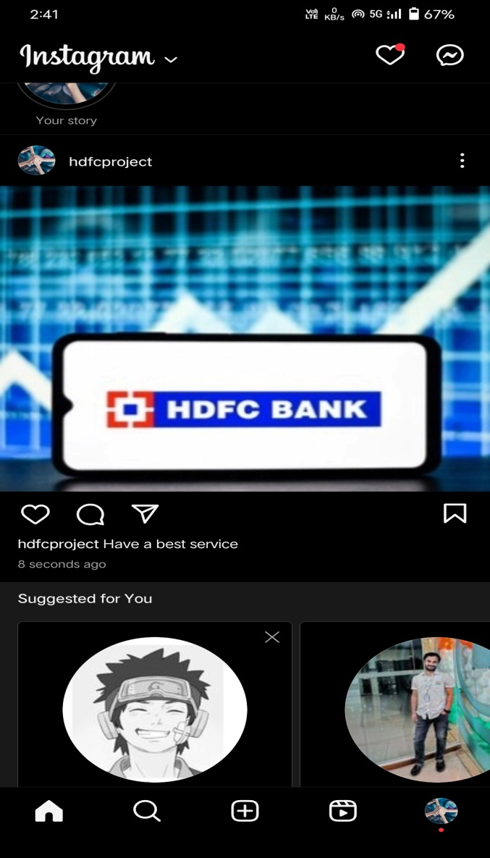
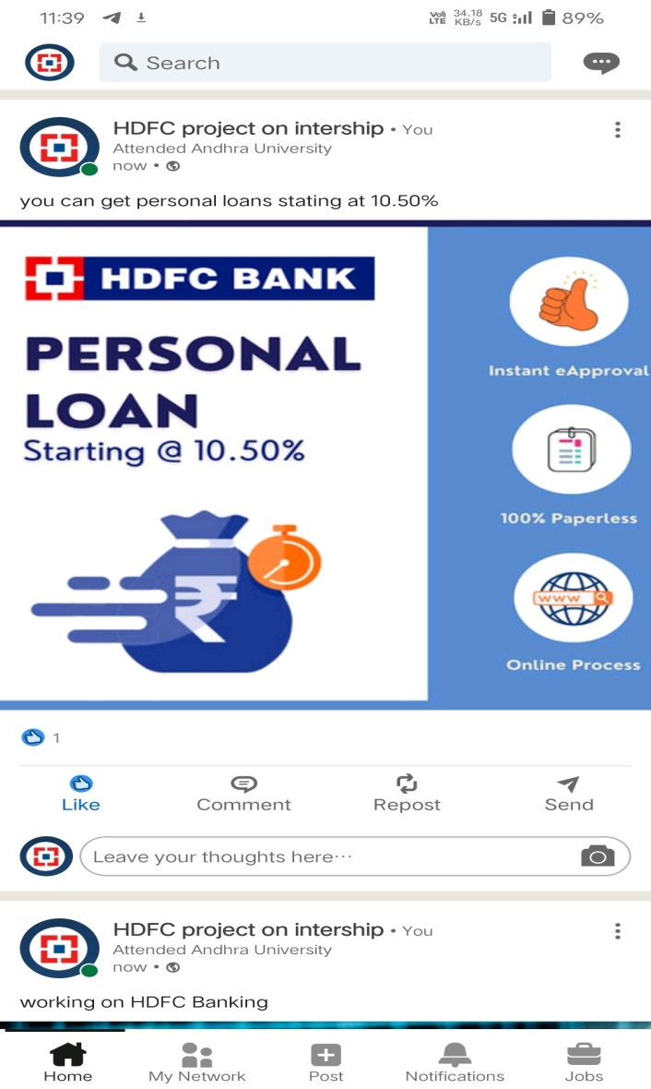
Social Media Ad Campaigns on HDFC Bank

Slide 17
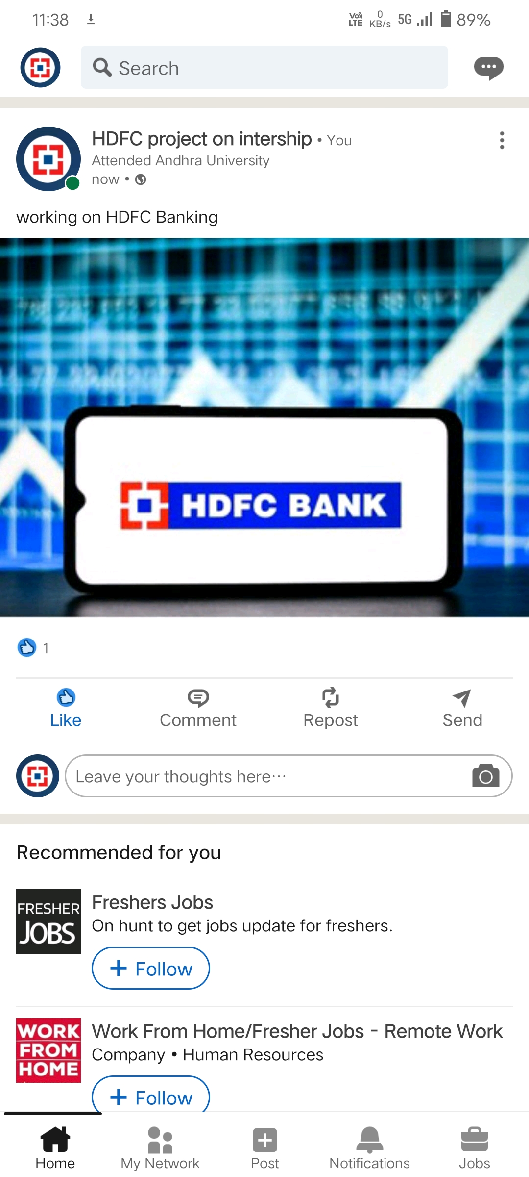
Linkedin

Slide 18

Facebook

Slide 19

Instagram

Slide 20
Advertising Goals
HDFC also employs digital technology and other modern tools and ways to promote its brand and services, in addition to traditional marketing and promotion channels. The enterprise promotes its services via its website, including credit cards, credit, and other services. As a significant financial services organization, it has achieved a large market share in India throughout time. HDFC has strong brand shareholdings, which are based on a continual focus on client comfort. It was able, through service, to gain the trust of clients.These is about the advertising goals of HDFC Bank.

Slide 21
Audience Targeting
HDFC Bank's Retail business is targeted at individuals, salaried professionals, micro and small businesses, such as kirana stores, Self Help Groups (SHGs), and Non-Resident Indians (NRIs). The Bank caters to this segment by customising its products and services. It enjoys a strong position in the Auto Loan and Personal Loan businesses and a leadership position in the Payments business. The Bank also offers Wealth Management Services to High Networth Individuals.

Slide 22
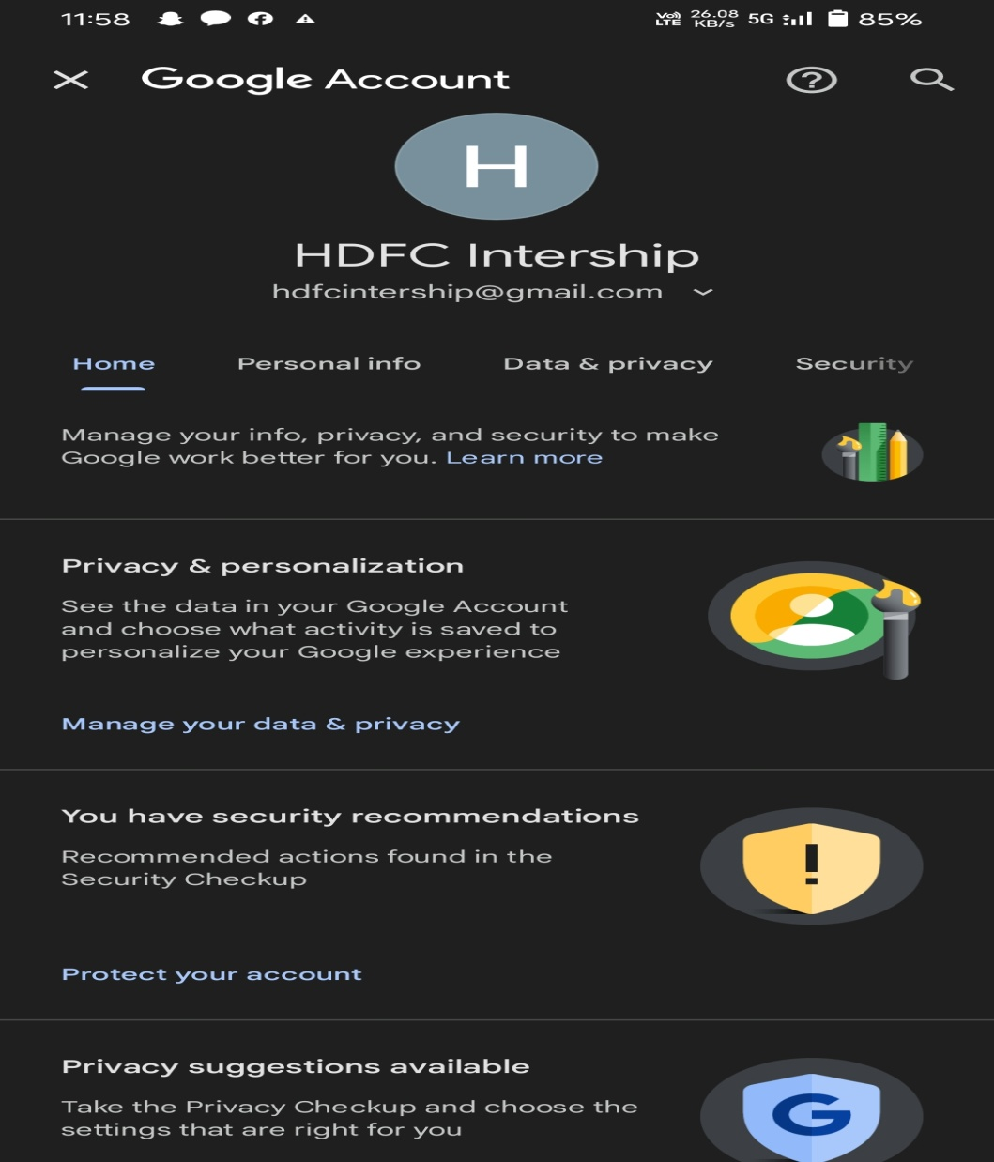
Email Ad Campaign
In partnership with Adobe, HDFC Bank has developed a comprehensive email marketing solution based on Adobe Campaign that will span multiple outbound channels including email, SMS, social and mobile apps.
"The ongoing digital revolution has opened up an array of opportunities as well as challenges for companies across the world.

Slide 23
Challenges faced and Lessons learned in these Internship
Wherever there is success in digital marketing, it always comes with its own set of digital marketing challenges. The Indian digital marketing industry has seen tremendous growth in the last 5 years. Young aspirants and companies have been looking for more opportunities to grow in this field.
I am currently in my final semester at Dr.L.B College, completing my internship in digital marketing. I had the privilege of being hired as a fall intern at SMART BRIDGE. Over the past few months, I have learned so much from these internship. This experience has taught me a lot of new skills and really opened my eyes to how a marketing agency functions.

Slide 24
THANK YOU

Slide 25
Team Members
DWARAPUDI AVINASH (Team Leader)
GURUGUBELLI REVANTH KUMAR
GOLAGANI LALU PRASAD YADAV
DUNNA SAHIL
GURI BHARATH KUMAR

